Slide 1
Towards The Unsupervised Detection of Novel RFI Sources
Participants:
Sean Bohun (UOIT),
Nicholas Bruce (UVic),
Chris Budd (Bath),
Ryan Campbell (McGill),
Rory Coles (UOIT),
Dave DelRizzo (DRAO),
Stephen Harrison (DRAO),
Seth Siegel (McGill)

Slide 2
Introduction
The Dominion Radio Astrophysical Observatory (DRAO) is located in a geographically isolated region near Penticton B.C.
This is the site of a multitude of sensitive RF detectors that require a quiet RF spectrum to effectively operate.
For any given day, the site can experience any number of transient RF signals due to a variety of sources.

Slide 3
IPSW Questions
DRAO would like to develop the capability to:
Classify and Cluster the set of known RF sources as they are determined
Identify any novel RF sources that have not been previously classified
Provide a set of descriptors for each novel source
Update the clusters dynamically as novel sources are identified
Once identified, the hope is that any novel sources can be eliminated with this technique.

Slide 4
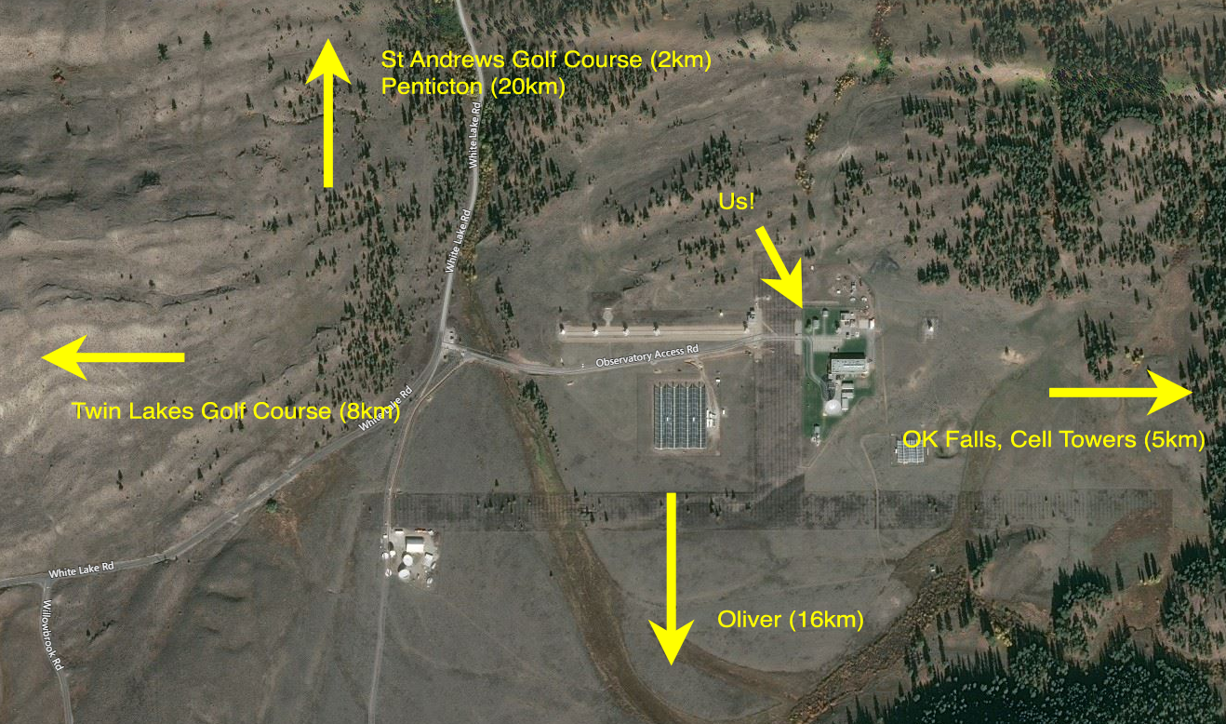
Site map

Slide 5
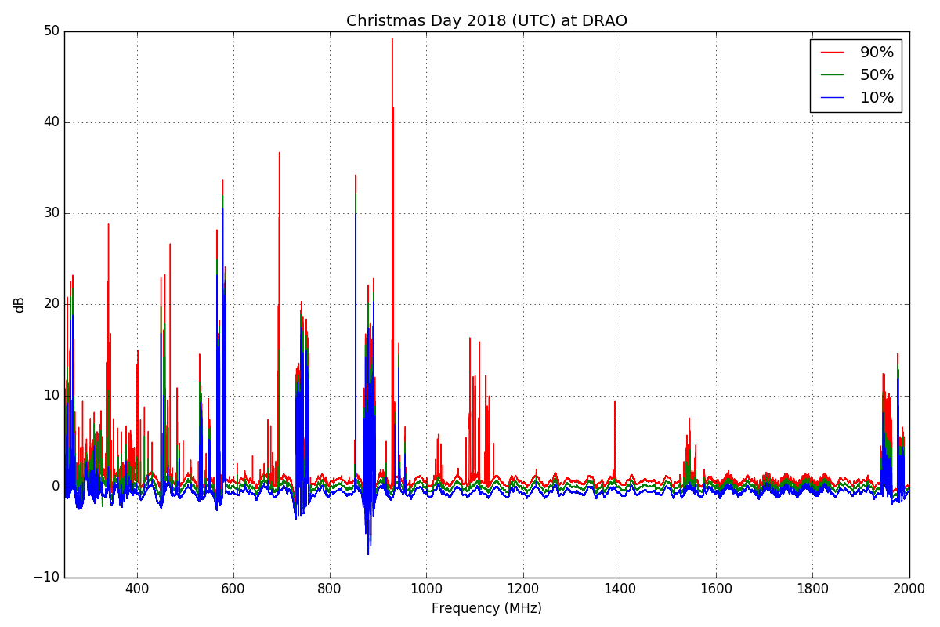
RFI: Static

Slide 6
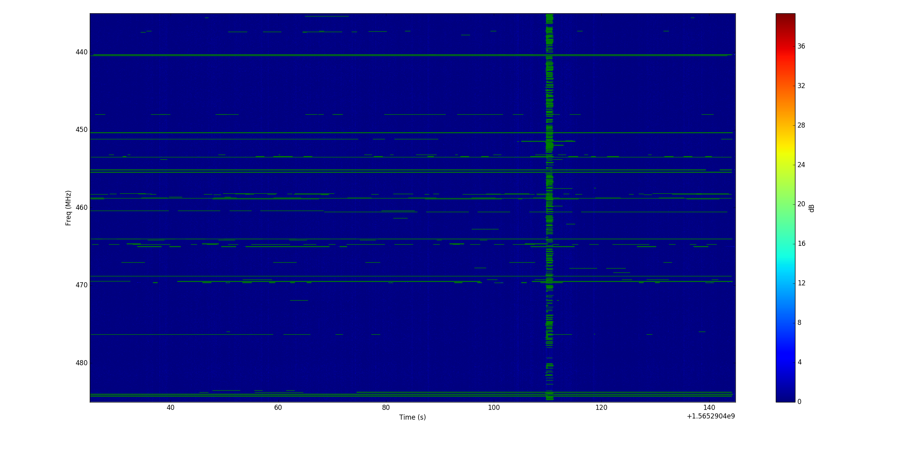
The Dynamic RF Scene
Detection of RFI in time-frequency space.
ML bounding box approach.
Notes:
50 MHz for 2 minutes. This is the data we brought, 30 files like this (1 hour of observing). We want to observe 2000 MHz for all day every day.
1kHz frequency resolution
100ms time resolution. We would like to observe higher cadence.
Bounding box approach tries to draw a box around the frequency and time range in which one signal exists.
Point out vertical stripe: Some electrical equipment generates a short wideband burst of RF energy. This is a different class of events, but we are interested in characterizing them.

Slide 7
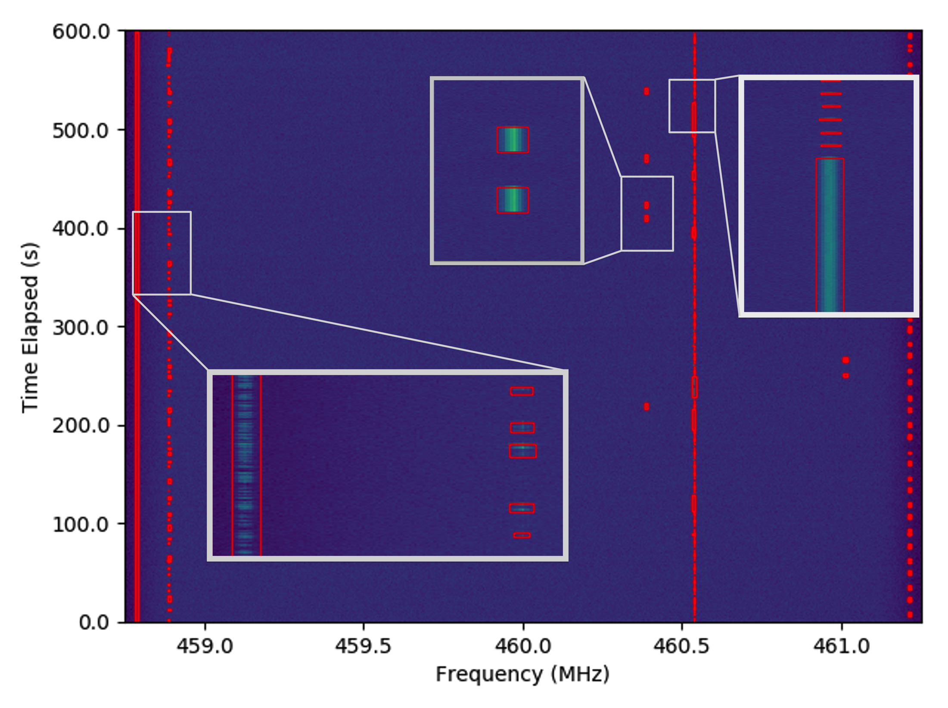
Separate the signals by using a bounding box

Slide 8
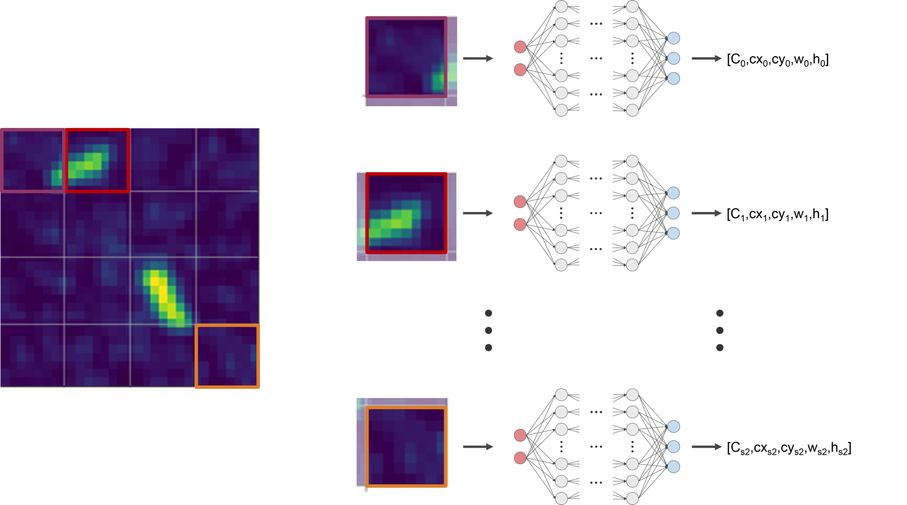

Slide 9
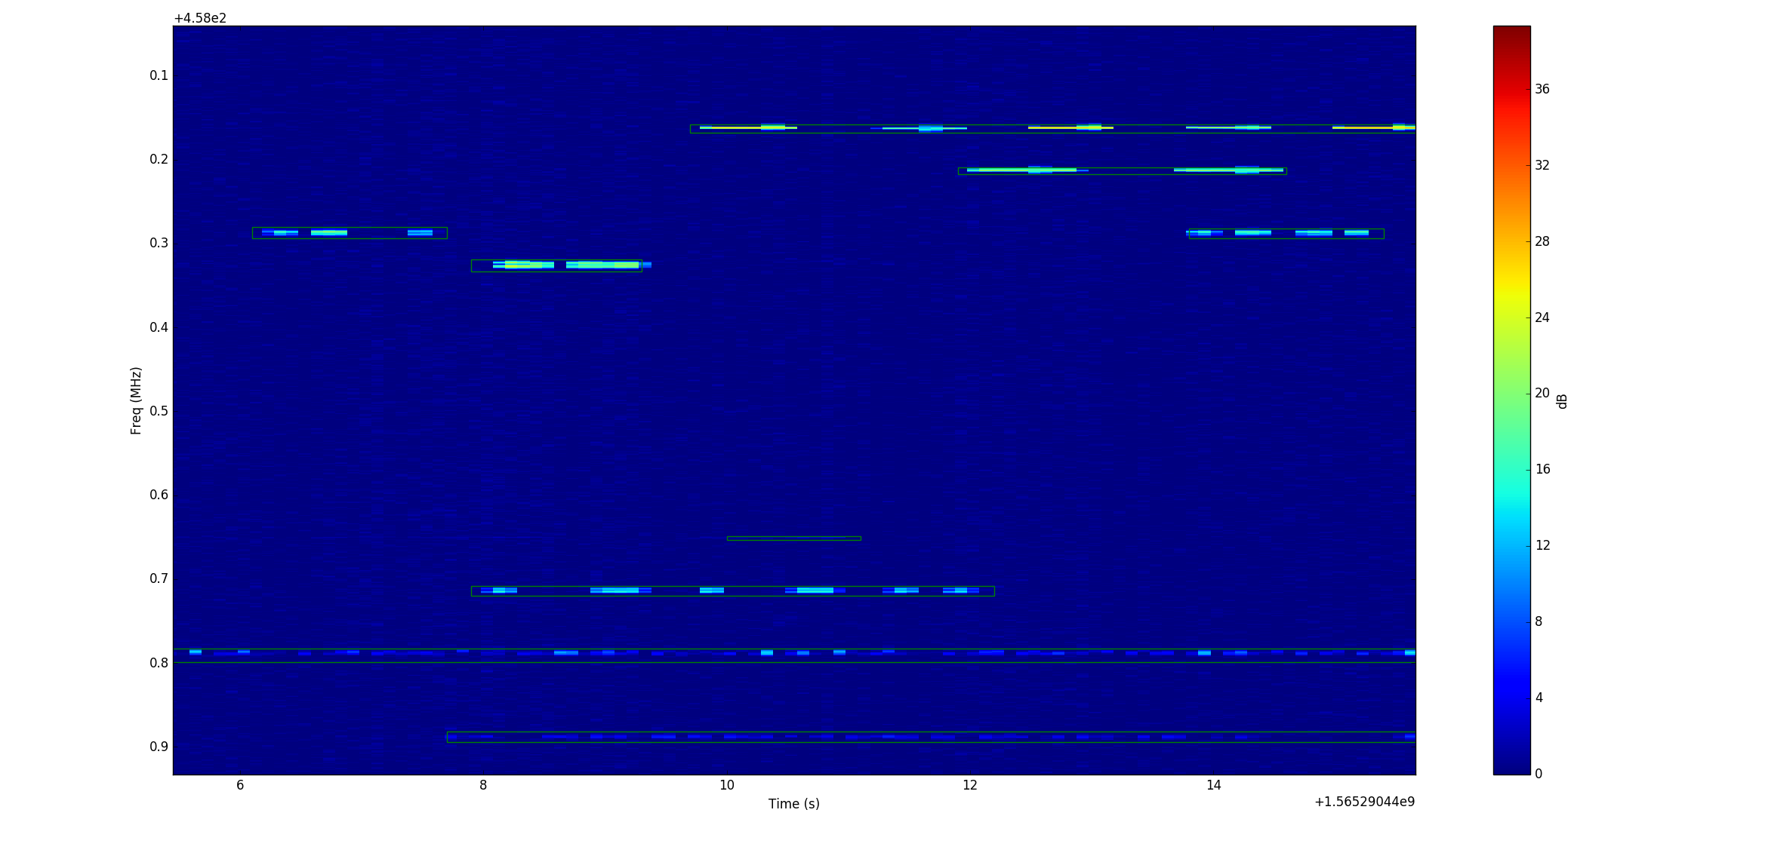
Results: Separated signals

Slide 10
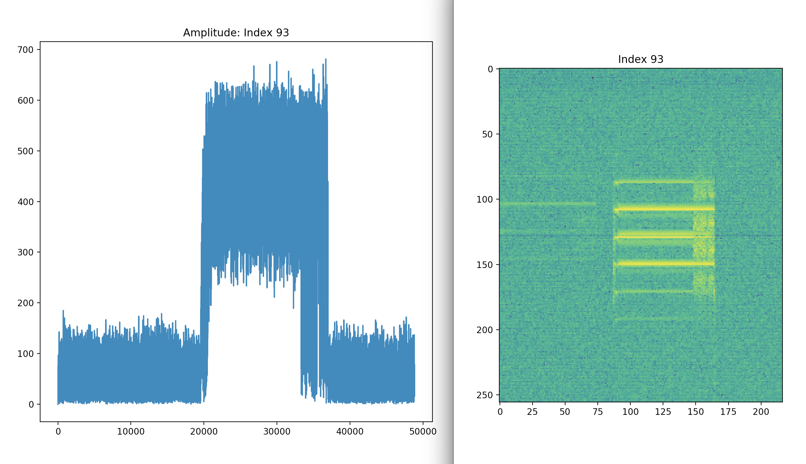
Sample signal types Short tone burst
Spectrograph
A
f
t
t

Slide 11
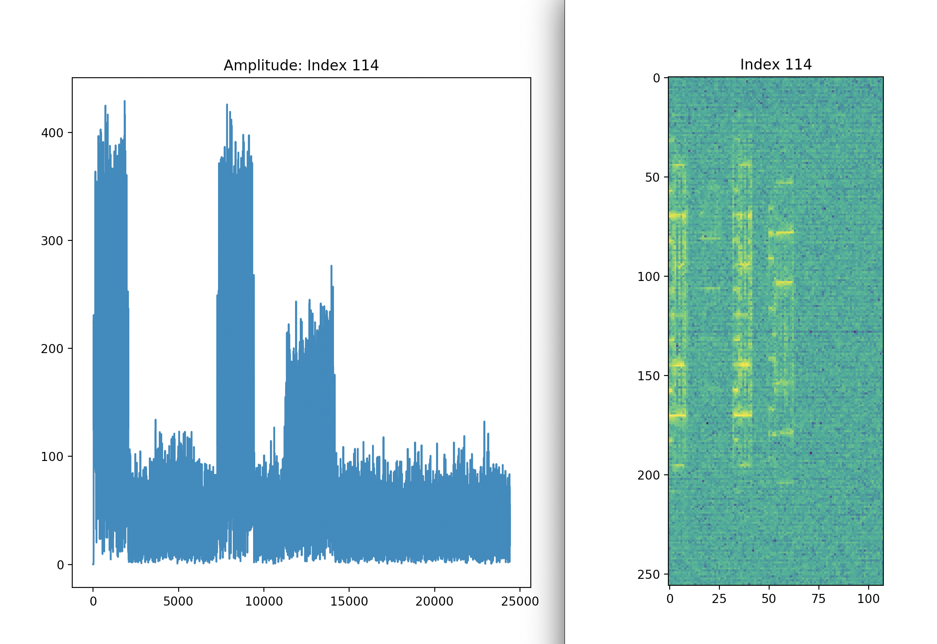
Frequency Shift Key (FSK)

Slide 12
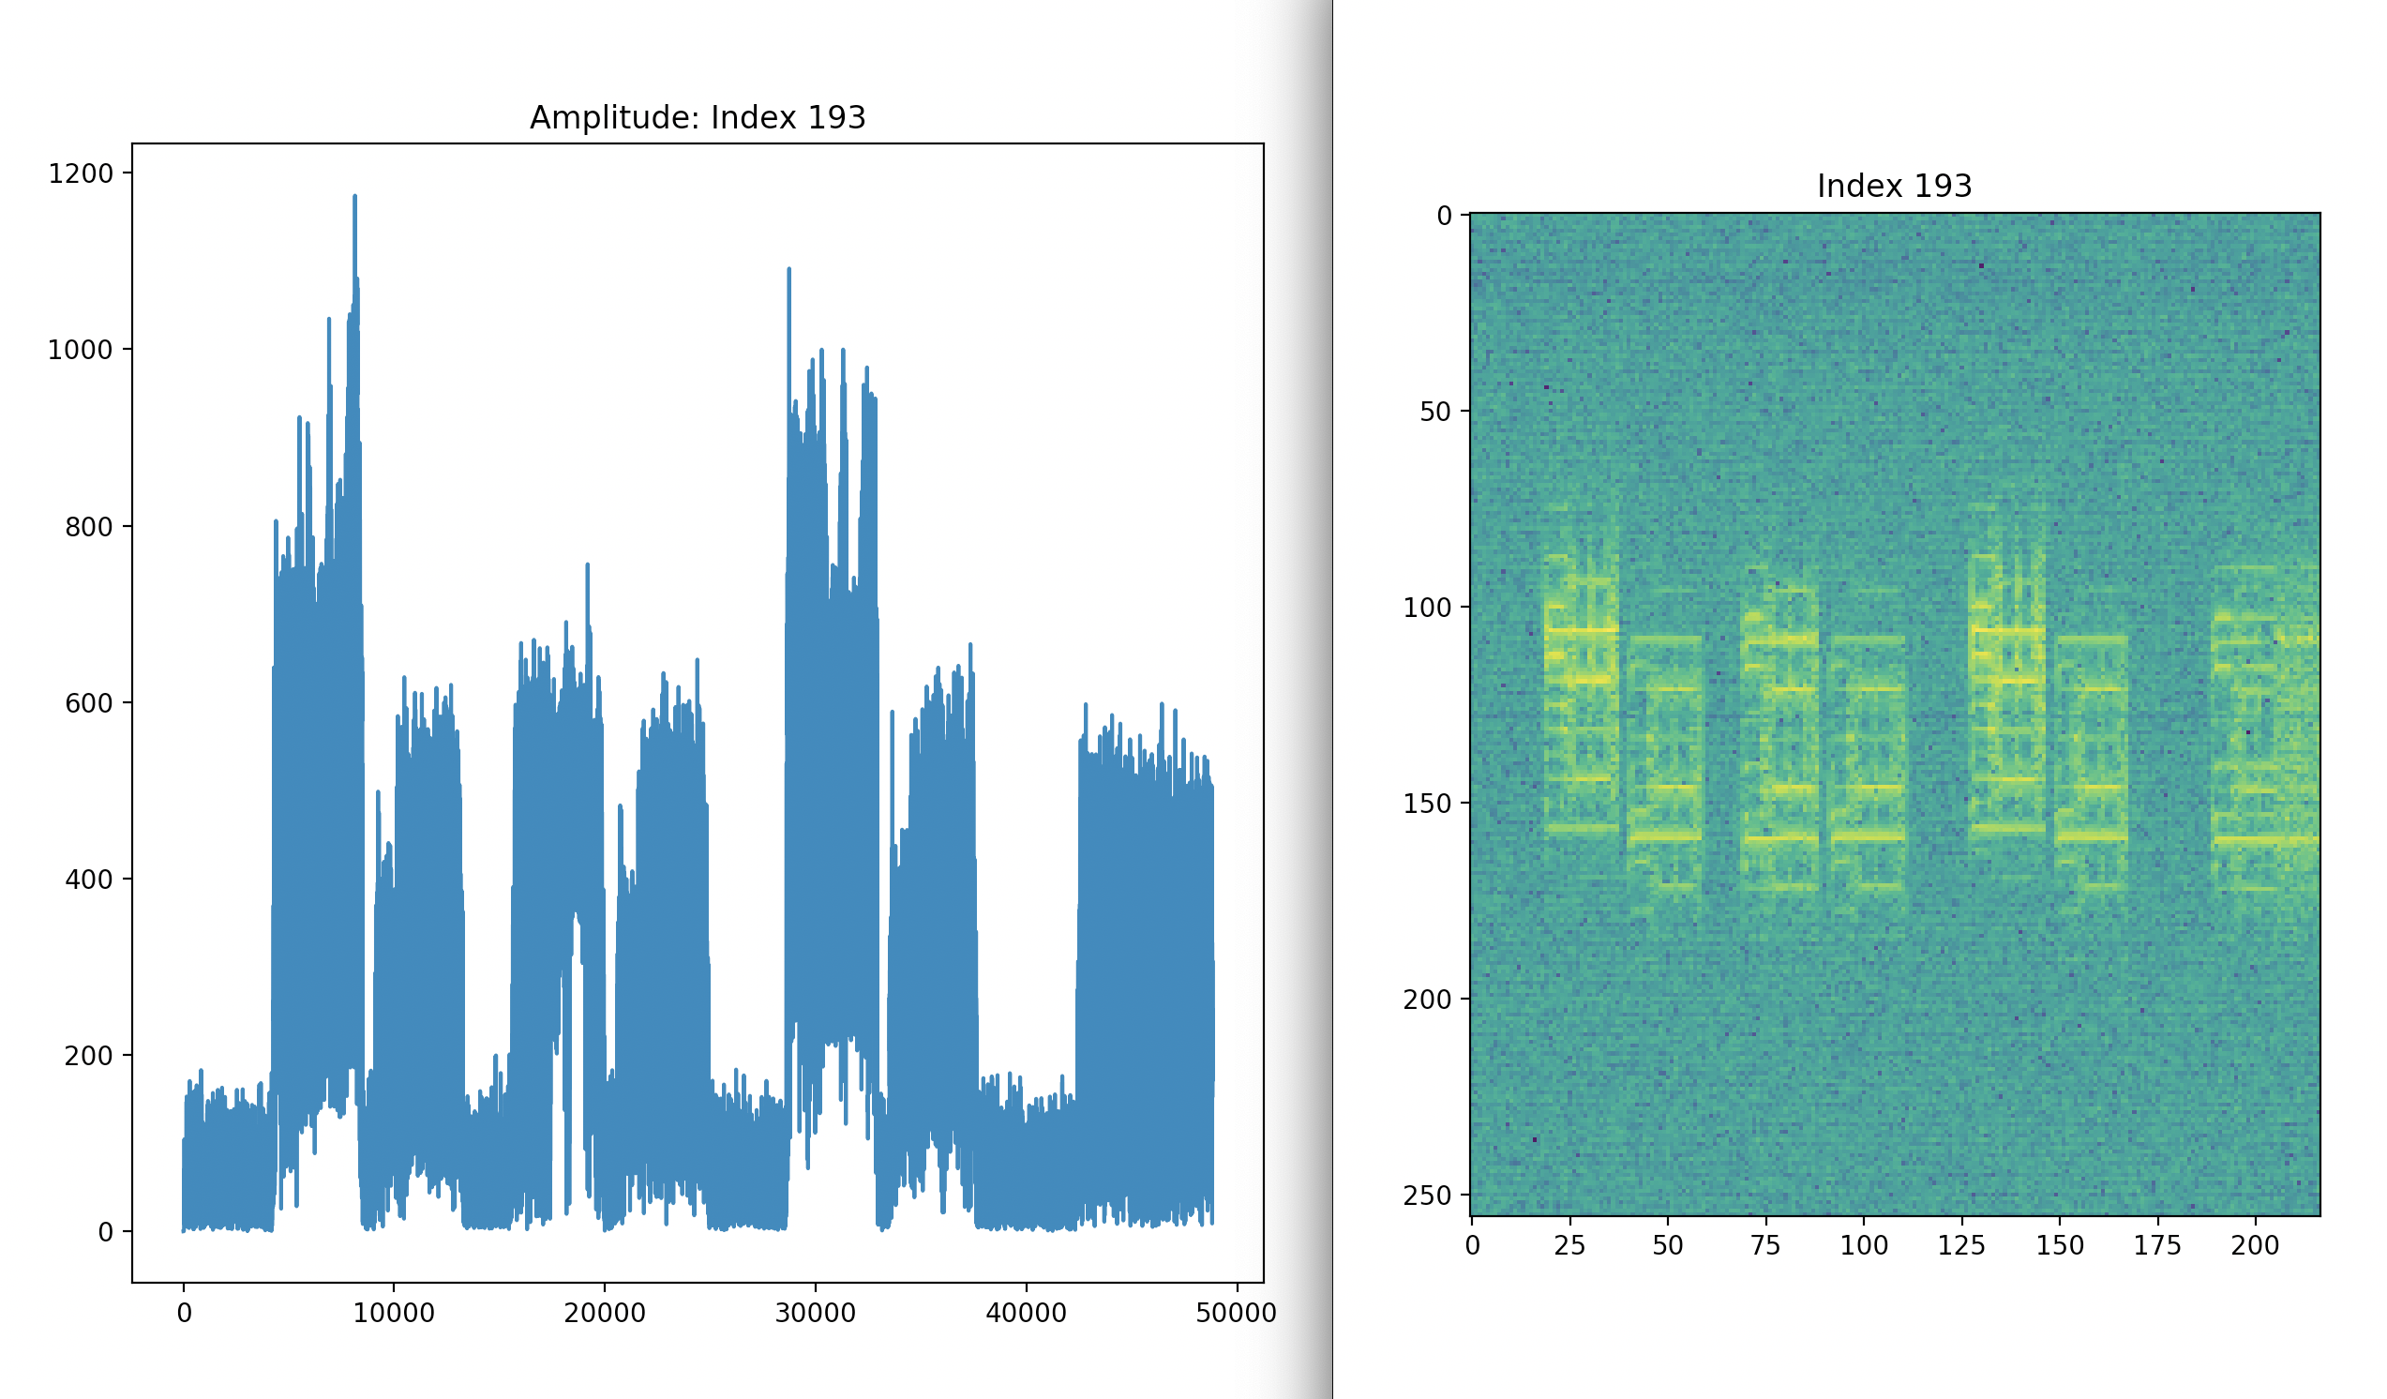
Amplitude Shift Key (ASK)

Slide 13
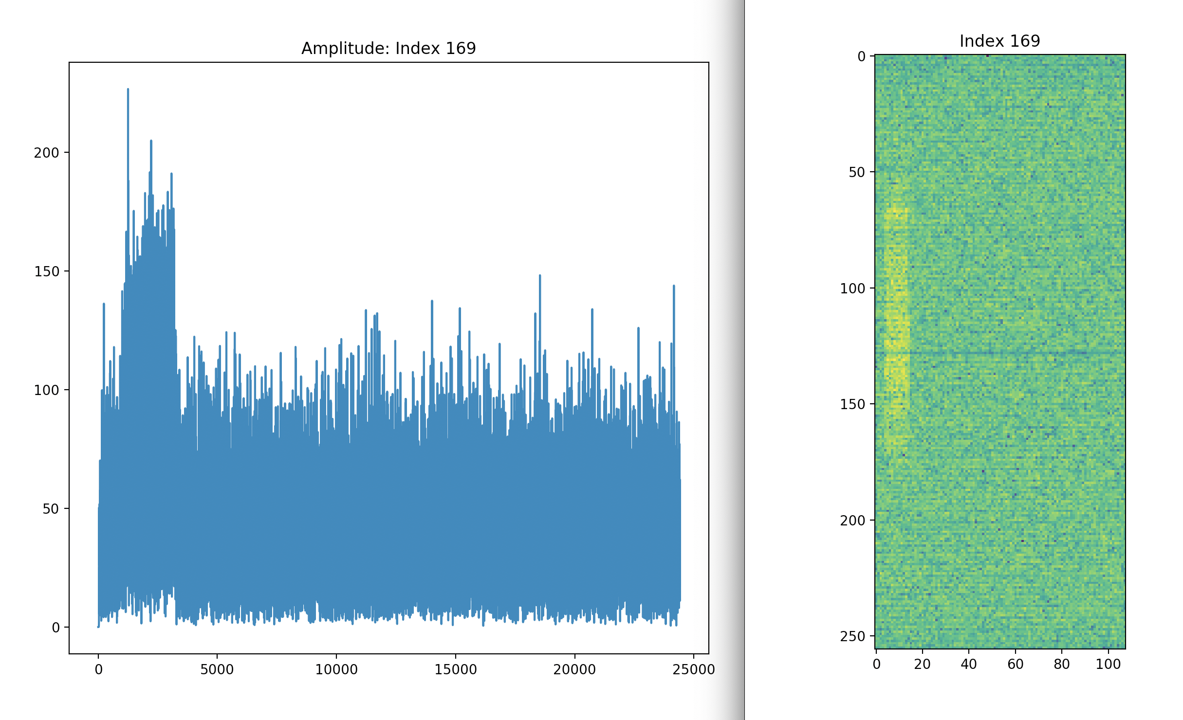
Noisy burst

Slide 14
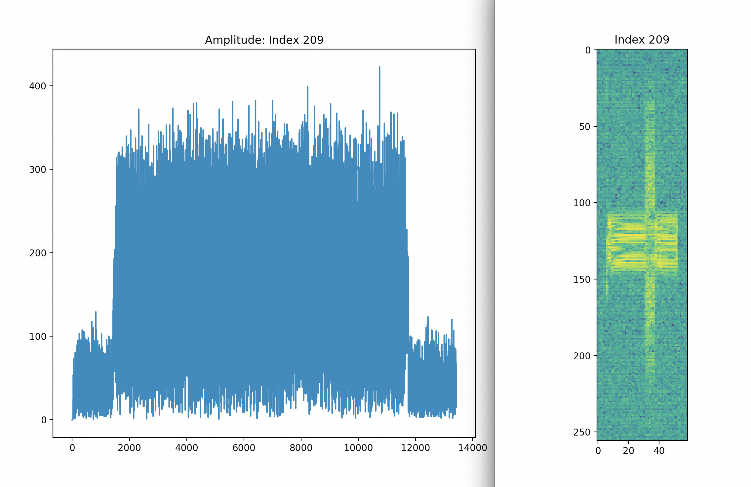
Unknown (Box)

Slide 15
Want to differentiate between different signals
Signals have different modulation types
eg:
Analogue: AM, SSB,DSB, FM, PM,
Digital: ASK, FSK, PSK, QAM, BPSK
Can separate signals by looking at their modulation types

Slide 16
Cumulants
Higher order cumulants are claimed to be able to do this
Higher order moment
Higher order cumulant

Slide 17
Papers claiming this base their claims on using polynomial supervised learning from synthetic data!
We are using unsupervised learning from real data

Slide 18
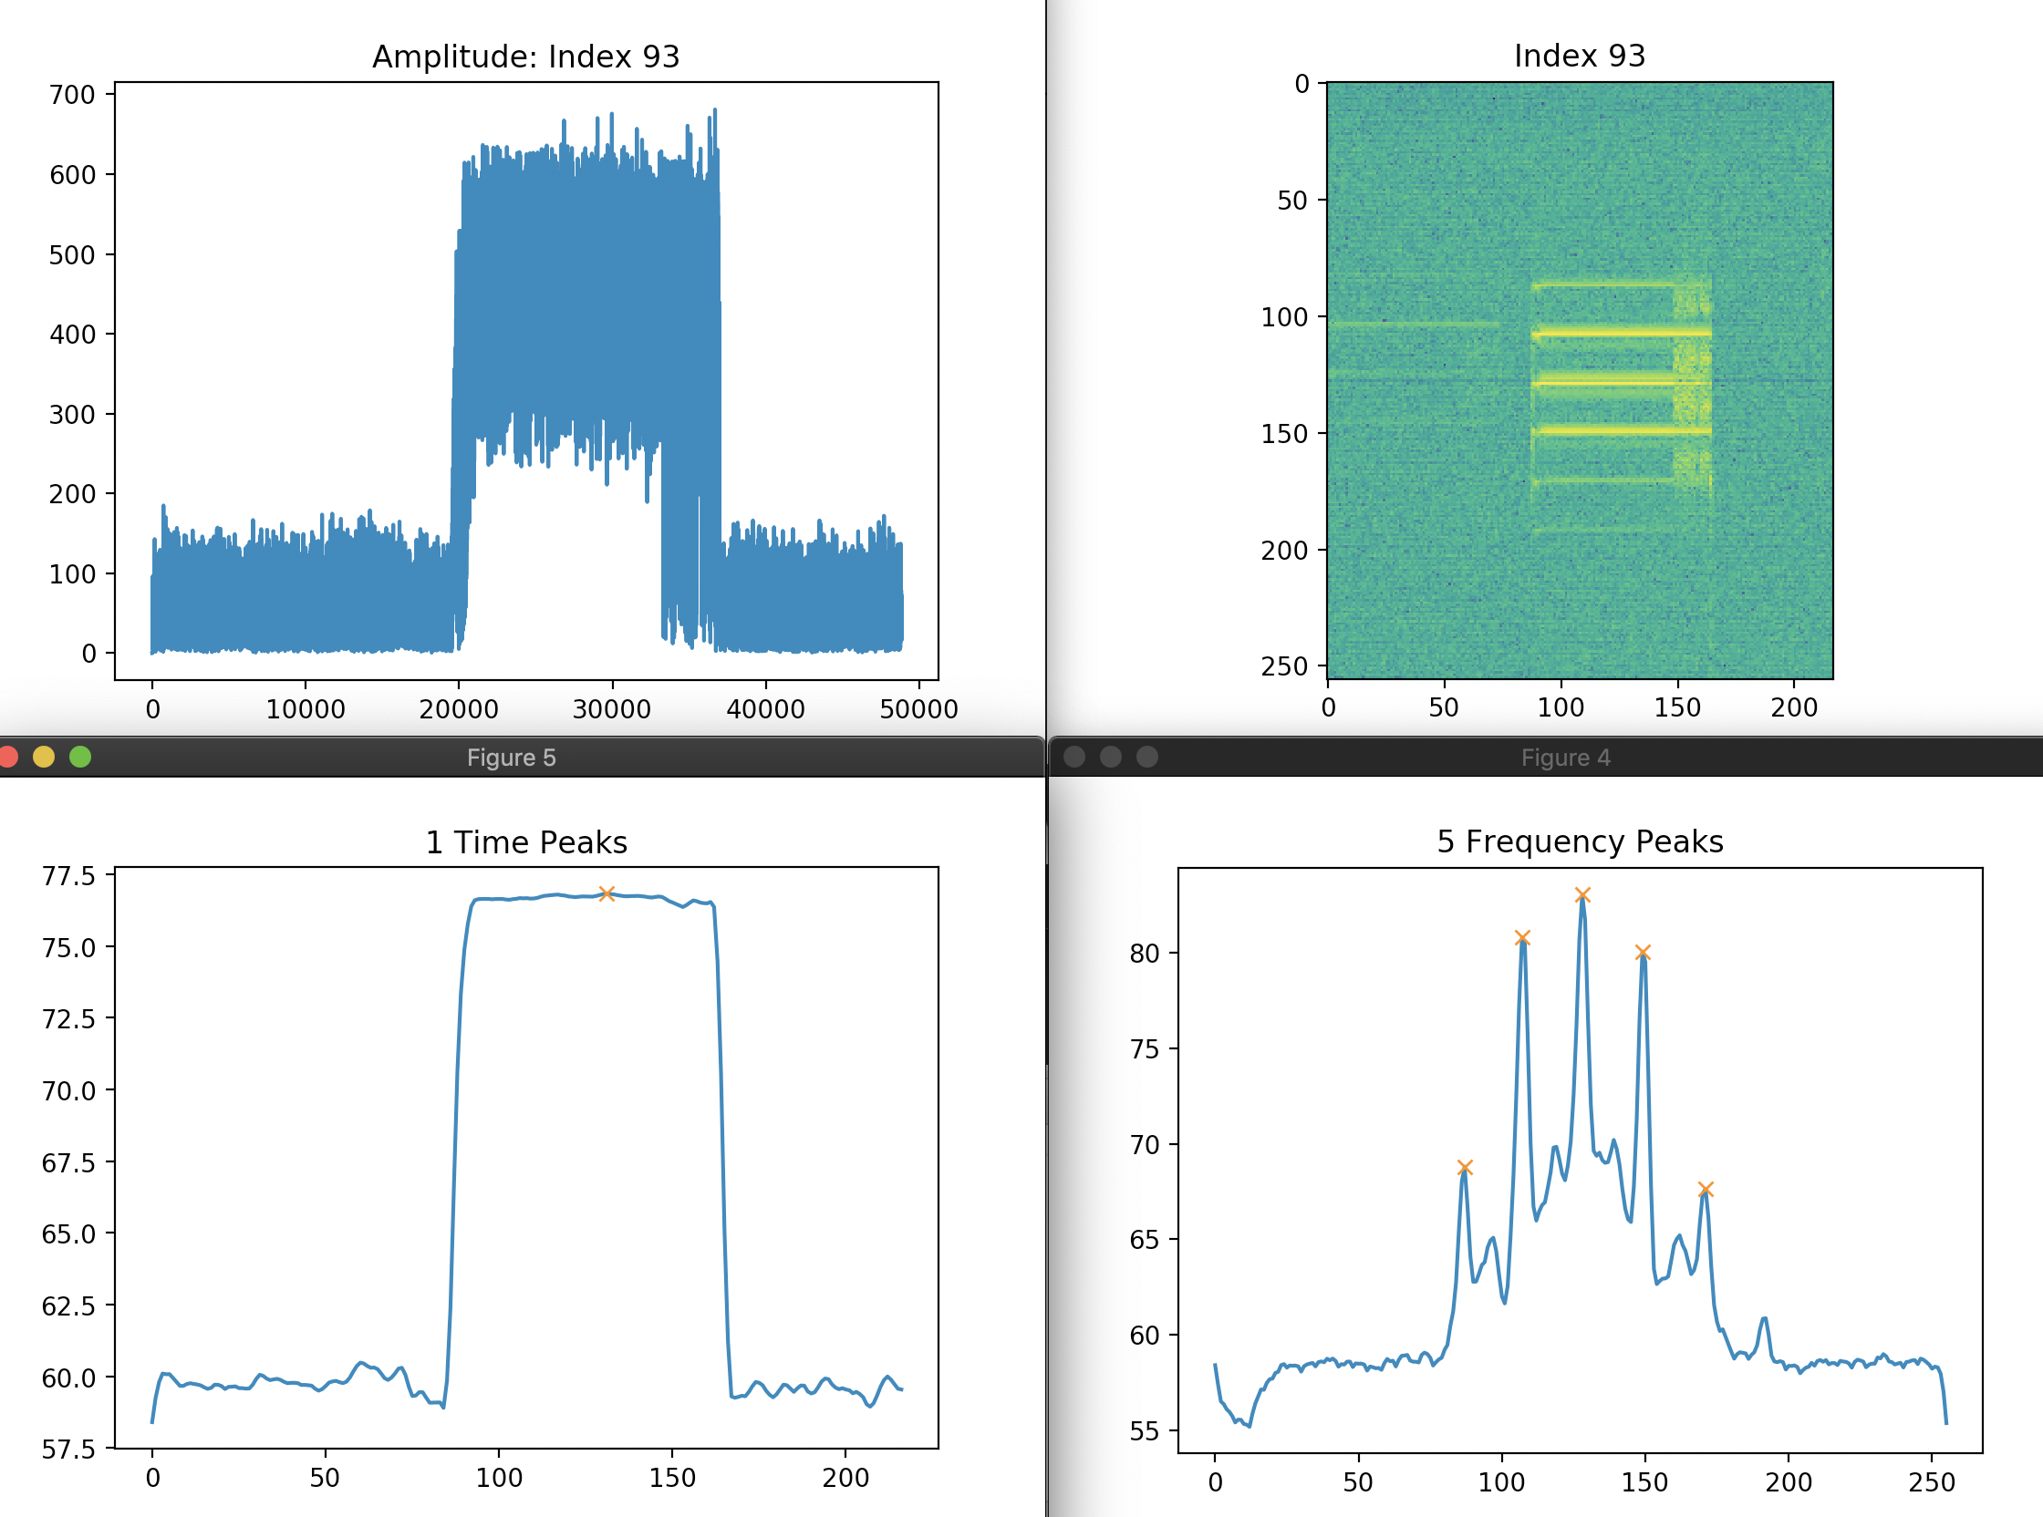
Also: Count the number of time and frequency peaks

Slide 19
Features vector
From each detection, the following 13 features were extracted for use in clustering:
Number of peaks in the frequency direction
Number of peaks in the time direction
Prominence of the major frequency peak
Avg. spacing of the frequency peaks
Avg. spacing of the time peaks
Normalized power centroid in the time direction
Width in the frequency direction (channels)
Center Frequency (Hz)
Bandwidth (Hz)
C₄₂ (4th order power cumulant)
C₆₃ (6th order power cumulant)
Transmission length (seconds)
P_{db} (2nd order power cumulant)

Slide 20
Clustering the feature vectors in the data
Various algorithms exist for clustering: DBSCAN, WARD (Matlab)
Cluster on the cumulants

Slide 21
Cluster on number of time and frequency peaks

Slide 22
Hierarchical clustering
The two cluster indices appear to be independent
Time-frequency cluster index: tf
Cumulant index: cc

Slide 23
Combine the cluster indices
Give a combined cluster index vector
I = (cc,tf)
This seems to be effective in classifying the signals and identifying new signals

Slide 24
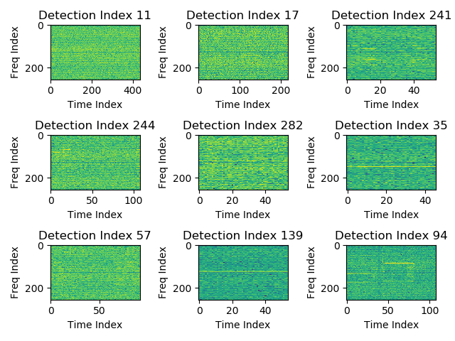
Cluster 1: I = (2,4)

Slide 25
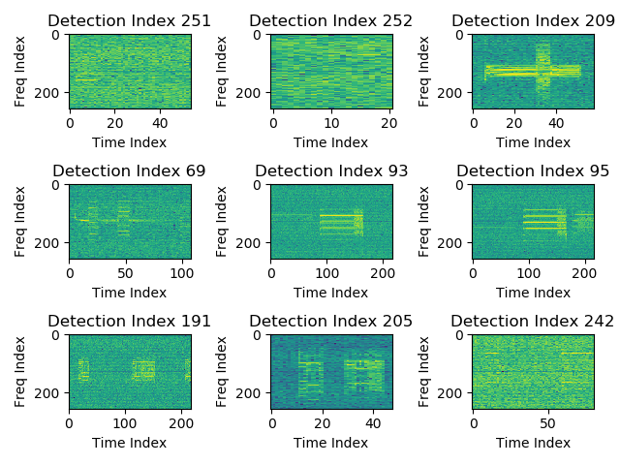
Cluster 2: I = (2,2)

Slide 26
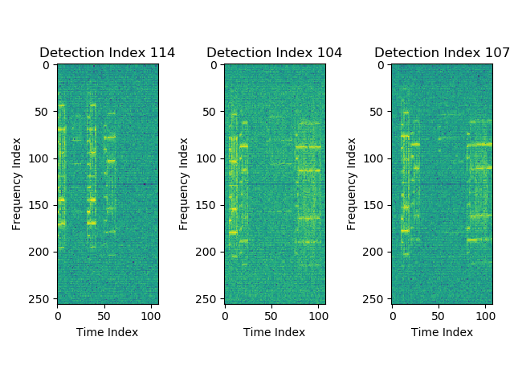
Cluster 3: I = (1,3)

Slide 27
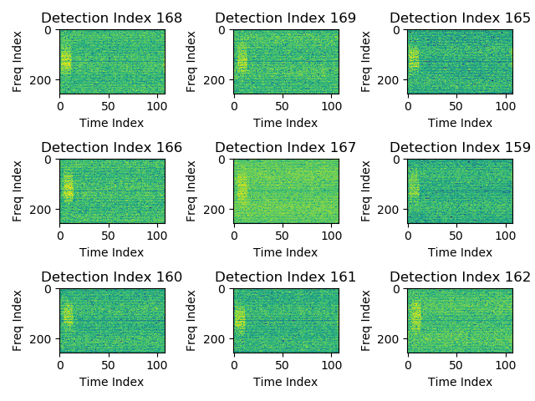
Cluster 7: I = (1,4)

Slide 28
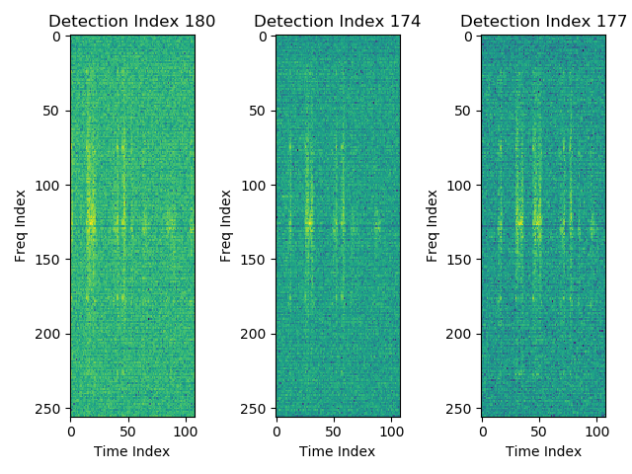
Cluster 8: I = (1,1)

Slide 29
Autoencoder approach
Separately, two methods were tried using a convolutional autoencoder on the baseband time-series data:
The first idea is to shove all the signals into the encoder, and use the latent feature space for clustering (in progress)
The second idea is to not cluster, instead training the autoencoder on the full dataset, then compute the difference between the input and the reconstruction. If the error is large enough, it’s “anomalous”.

Slide 30
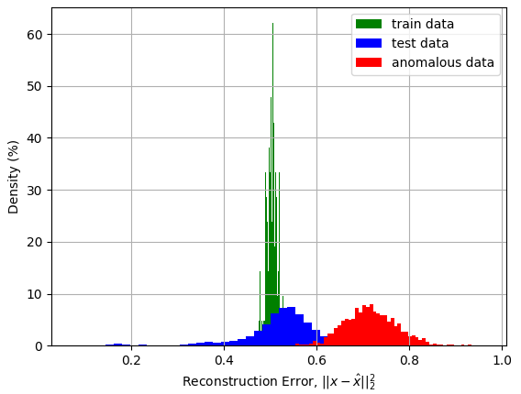
Autoencoder approach
First it was trained on all of the dataset with a P_{db} greater than 40 dB, then compared with simulated pure white noise (on the right)
Next a collection of real signals known to be noisy was used for training, and then the rest were for testing (in progress)
The following slides show the process of separating those signals using a parallel coordinates plot

Slide 31
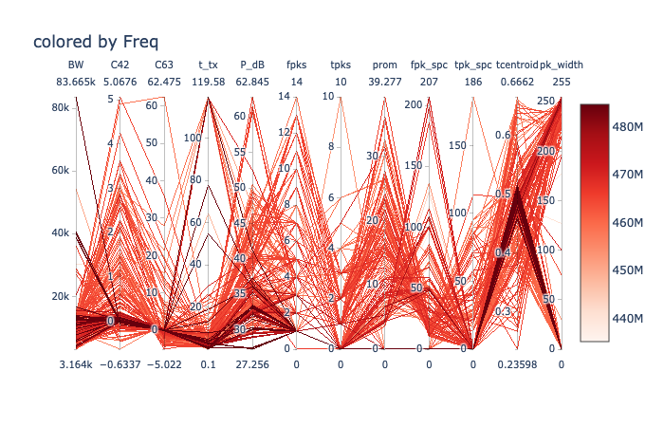
Full dataset

Slide 32
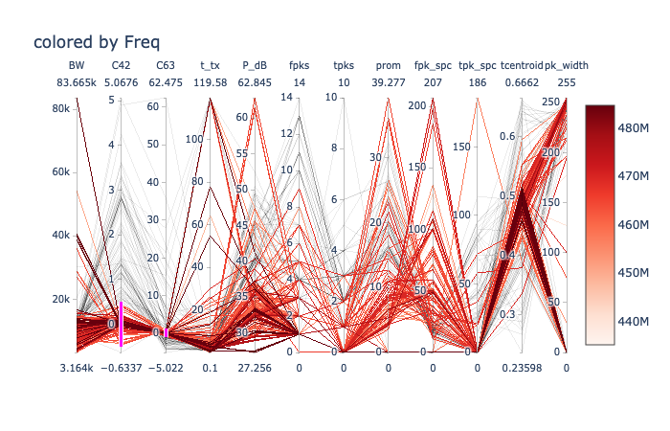
Dataset for training (see pink)

Slide 33
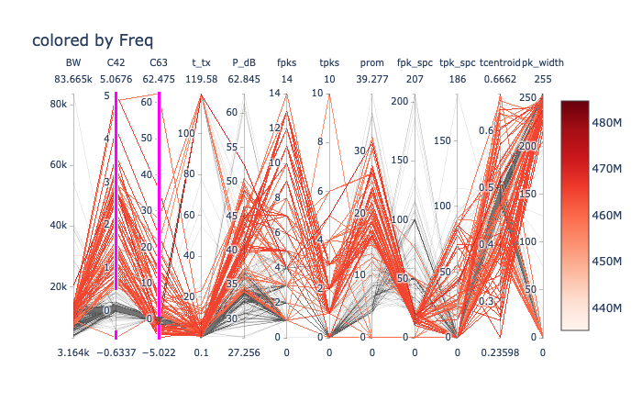
Data for testing (see pink)

Slide 34
Conclusions
Building on the unsupervised detection, it was found that cumulants C42 and C63 alone were insufficient to cluster incoming RFI signals.
This is in contrast to other researcher claims that cumulants are sufficient. However this claim was based on supervised learning algorithms using synthetic data and not unsupervised leaning on real data.
Cumulants combined with extra information of the number of peaks in the time domain and the frequency domain, were sufficient to classify the incoming signals.
When tested on a subsequent dataset, this scheme detected a new cluster providing some confidence as to its future capability.

Slide 35
Future work
Autoencoder implementations are currently in progress.
One uses all the data and is attempting to cluster based on the latent feature space.
2) A second also uses all the data but tried to reconstruct the signal.
An inability to be able to do this task would identify a signal as novel.
A system that combines the bounding box technique to separate signals with the clustering is in the process of being implemented.

